Slide 1
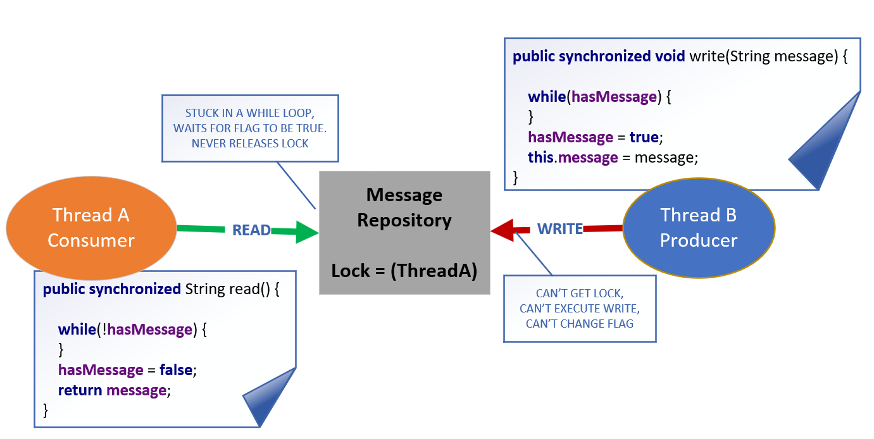

Deadlock in the Consumer Producer Example
In an earlier video, I demonstrated a deadlock, with the Consumer Producer sample code.
Both classes were accessing a single boolean field, on a shared object, in a while loop with no code in it.
We resolved this situation by using the notifyAll, and wait methods on object, in both of these methods.
COMPLETE JAVA MASTERCLASS
Revisiting Deadlock, and Other Common Problems

Slide 2
The Common Problems in a Multi-Threaded Application
Problem | Description
Deadlock | Two or more threads are blocked, waiting for each other to release a resource.
Livelock | Two or more threads are continuously looping, each waiting for the other thread to take some action.
Starvation | A thread is not able to obtain the resources it needs to execute.
COMPLETE JAVA MASTERCLASS
Revisiting Deadlock, and Other Common Problems

Slide 3
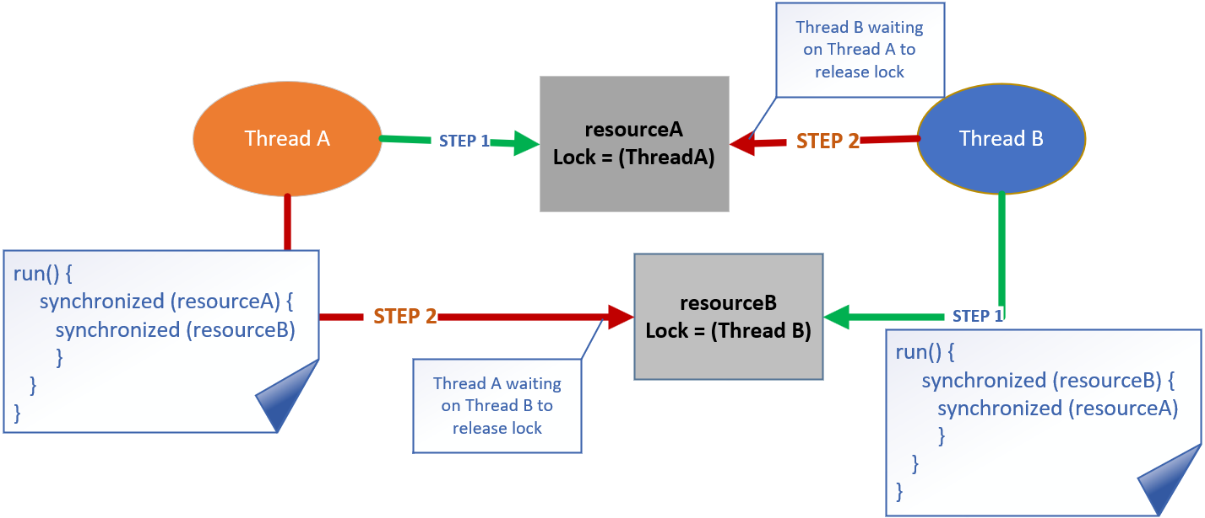
A Second Deadlock Scenario
When both threads need access to multiple resources in a certain order, this can cause contention, and produce a deadlock.
COMPLETE JAVA MASTERCLASS
Revisiting Deadlock, and Other Common Problems

Slide 4
Preventing Deadlocks
A couple of common ways to avoid this kind of deadlock situation, are listed here.
Organize your locks into a hierarchy, and ensure that all threads acquire locks in the same order to avoid circular waiting, which is a common cause of deadlocks. This approach helps establish a global lock order that all threads must follow.
Instead of using traditional synchronized blocks or methods, you can use the tryLock method on the Lock interface. This method allows you to attempt to acquire a lock. If it fails, you can handle the situation without causing a deadlock.
COMPLETE JAVA MASTERCLASS
Revisiting Deadlock, and Other Common Problems

